Slide 1
Low Rank Tensor Completion Algorithm
Simple Low Rank Tensor Completion

Slide 2

Simple Low Rank Tensor Completion——SiLRTC
Objective Function
Low Rank Matrix Completion
$$\min_{X}{rank(X)} s.t. X_{Ω}=T_{Ω}$$
$$\min_{X}{{\left\|X\right\|}_{∗}} s.t. X_{Ω}=T_{Ω}$$
Low Rank Tensor Completion
$$\min_{χ}{{\left\|χ\right\|}_{∗}} s.t. χ_{Ω}=Τ_{Ω}$$
${\left\|χ\right\|}_{∗}= \sum_{i=1}^{N}{α_{i}{\left\|χ_{\left(i\right)}\right\|}_{∗}} α_{i}≥0 and \sum_{i=1}^{N}{α_{i}}=1$
$$\min_{χ}{\sum_{i=1}^{N}{α_{i}{\left\|χ_{\left(i\right)}\right\|}_{∗}}} s.t. χ_{Ω}=Τ_{Ω}$$

Slide 3
Objective Function(SiLRTC)
$$\min_{χ}{\sum_{i=1}^{N}{α_{i}{\left\|χ_{\left(i\right)}\right\|}_{∗}}} s.t. χ_{Ω}=Τ_{Ω}$$
$$\min_{χ,M_{i}}{\sum_{i=1}^{N}{α_{i}{\left\|M_{i}\right\|}_{∗}} }s.t. χ_{\left(i\right)}=M_{i} , i=1,…,N and χ_{Ω}=Τ_{Ω}$$
$$\min_{χ,M_{i}}{\sum_{i=1}^{N}{α_{i}{\left\|M_{i}\right\|}_{∗}+\frac{λ_{i}}{2}{\left\|χ_{\left(i\right)}−M_{i}\right\|}_{F}^{2}}} s.t.χ_{Ω}=Τ_{Ω} and λ_{i}>0$$
It's convex but not differentiable
Coordinate Descent
Choose an index i from 1 to n.
Choose a step size α.
Update $x_{i}$ to $x_{i}−α\frac{∂F}{∂x_{i}}(x)$

Slide 4
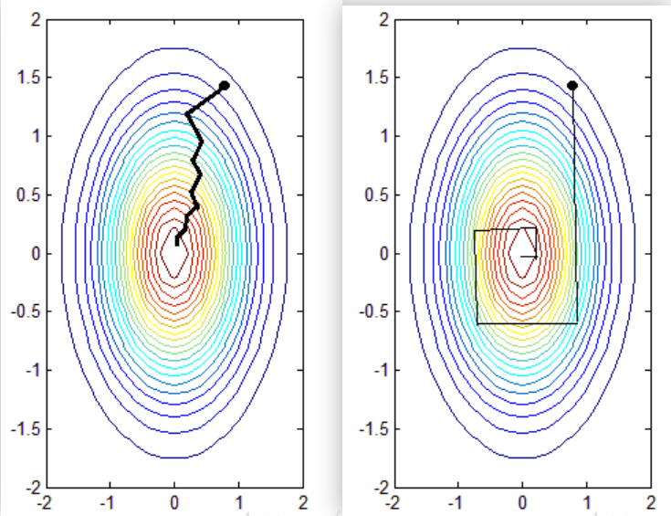
Block Coordinate Descent——BCD
By optimizing the subset of variables simultaneously.

Slide 5
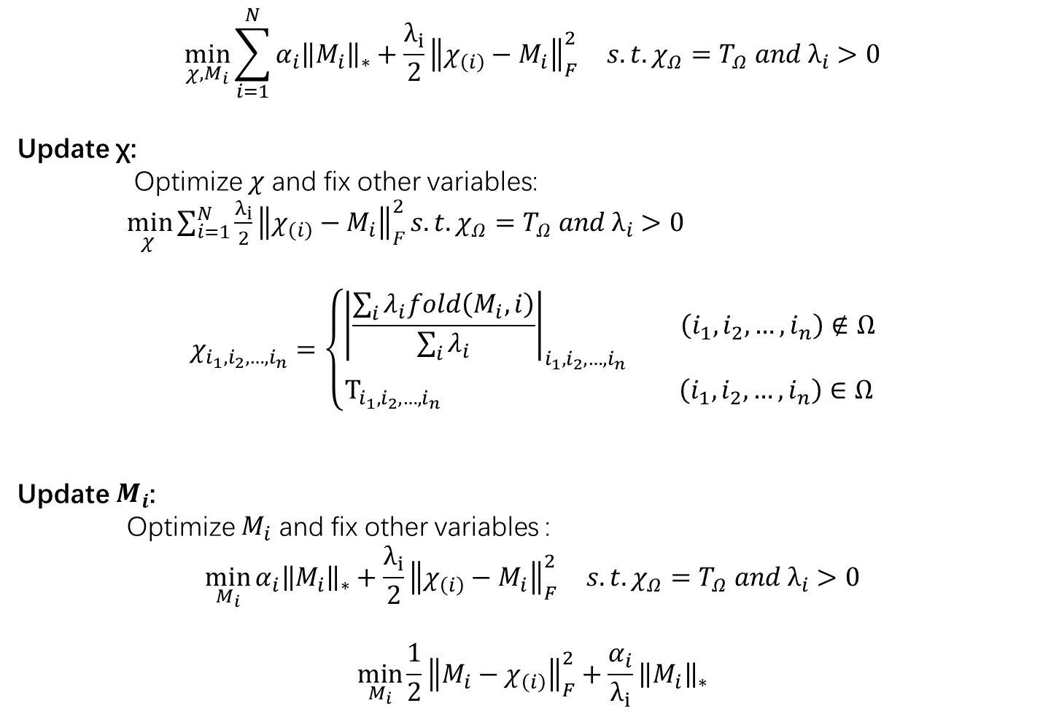
$$\min_{χ,M_{i}}{\sum_{i=1}^{N}{α_{i}{\left\|M_{i}\right\|}_{∗}+\frac{λ_{i}}{2}{\left\|χ_{\left(i\right)}−M_{i}\right\|}_{F}^{2}}} s.t.χ_{Ω}=Τ_{Ω} and λ_{i}>0$$
Update χ:
Optimize $χ$ and fix other variables:
$\min_{χ }{\sum_{i=1}^{N}{\frac{λ_{i}}{2}{\left\|χ_{\left(i\right)}−M_{i}\right\|}_{F}^{2}}}s.t.χ_{Ω}=Τ_{Ω} and λ_{i}>0$
$$χ_{i_{1},i_{2},…,i_{n}}=\left\{\begin{aligned}{\left|\frac{\sum_{i}{λ_{i}fold\left(M_{i}, i\right)}}{\sum_{i}{λ_{i}}}\right|}_{i_{1},i_{2},…,i_{n}} \left(i_{1},i_{2},…,i_{n}\right)∉Ω \\ Τ_{i_{1},i_{2},…,i_{n}} \left(i_{1},i_{2},…,i_{n}\right)∈Ω\end{aligned}\right.$$
Update $M_{i}$:
Optimize $M_{i}$ and fix other variables :
$$\min_{M_{i}}{α_{i}{\left\|M_{i}\right\|}_{∗}+\frac{λ_{i}}{2}{\left\|χ_{\left(i\right)}−M_{i}\right\|}_{F}^{2}} s.t.χ_{Ω}=Τ_{Ω} and λ_{i}>0$$
$$\min_{M_{i}}{\frac{1}{2}{\left\|M_{i}−χ_{\left(i\right)}\right\|}_{F}^{2}+\frac{α_{i}}{λ_{i}}{\left\|M_{i}\right\|}_{∗}}$$

Slide 6
Singular Thresholding Algorithm——SVT
$$\min_{M_{i}}{\frac{1}{2}{\left\|M_{i}−χ_{\left(i\right)}\right\|}_{F}^{2}+\frac{α_{i}}{λ_{i}}{\left\|M_{i}\right\|}_{∗}}$$
Using Singular Value Thresholding Algorithm(SVT) to solve this problem.
SVD of $χ_{\left(i\right)}$:
$$χ_{\left(i\right)}=UΣV^{T}$$
Getting $M_{i}$:
$$M_{i}=U{Ω_{\frac{1}{β}}(Σ)V}^{T}$$
$$Ω_{\frac{1}{β}}\left(Σ\right)=diag\left(\max\left(δ_{i}−\frac{1}{β},0\right)\right)$$
SiLRTC——Shortcomings:
The convergence rate is slow.
Cannot be extended to tensors of any order.

