Slide 1
Microsoft GCR CSS Ready to show Presentation
-- Lance Zhang

Slide 2
Tech topic
ASP.NET AJAX Performance Improvement
Notes:
Today, I would like to share some experience on how to improve the performance of ASP.NET AJAX

Slide 3
AJAX Overview
AJAX (asynchronous JavaScript and XML), is a group of interrelated web development techniques used for creating interactive web applications or rich Internet applications.
Notes:
I think everyone would agree that AJAX is one of the elements of “Web 2.0″, every web developers should know this technology.

Slide 4
AJAX frameworks
1.dojo 2.Rico 3.qooxdoo 4.tibet 5.Flash/JavaScript Integration kit 6.Google AJAXSLT 7.libXmlRequest 8.RSLite 9.SACK 10.sarrisa 11.XHConn 12.CPAINT 13.Sajax 14.JSON/JSON-RPC 15.Direct Web Remoting 16.SWATO 17.Java BluePrints 18.Ajax.Net 19.Atlas 20.Ruby on Rails 21.AFLAX 22.AjaxAC 23.AJAXExtended 24.Ajax.NET Professional 25.AjaxRequest Library 26.AHAH: Asychronous HTML and HTTP 27.Bajax 28.Code Snippets | 29.Cross-Browser.com 30.DHTML API, Drag & Drop for Images and Layers 31.DHTMLgoodies.com 32.DHTML Kitchen 33.dp.SyntaxHighlighter 34.Dynamic Drive 35.DynAPI 36.Ext JS (javascript library) 37.Engine for Web Applications 38.FACE 39.JSL : JavaScript Standard Library 40.Javascript Toolbox 41.jQuery - New Wave Javascript 42.JSAN - JavaScript Archive Network 43.JSFBGL - Javascript framebuffer graphics library 44.Kabuki AJAX Toolkit 45.LINB(Lazy INternet and Browser) 46.liberty 47.MochiKit 48.moo.ajax 49.moo.fx 50.overLIB | 51.overLIB 52.overlibmws DHTML Popup Library 53.Plex Toolkit 54.PlotKit - Javascript Chart Plotting 55.Prototype 56.qForms JavaScript API 57.sardalya 58.script.aculo.us 59.JonDesign’s Smooth SlideShow Library 60.Spry Framework for Ajax 61.Tabtastic 62.Taconite 63.Tacos 64.The Solvent 65.ThyApi 66.TwinHelix 67.TurboWidgets 68.UIZE JavaScript API 69.High Performance JavaScript Vector Graphics Library 71.WMS Javascript Library 72.Yahoo Design Pattern Library 73.Yahoo! User Interface Library | 74.Yahoo! UI Library 75.Zapatec AJAX Suite 76.Zebda 77.Zephyr 78.ZK 79.Backbase 80.Mootools 81.Clean AJAX 82.Wt 83.Echo 84.Google Web Toolkit 85.ThinWire 86.Symfony 87.Tigermouse 88.Xajax 89.AjaxAnywhere 90. ajaxCFC 91.AjaxTags component of Java Web Parts 92.AJS 93.Anaa 94.DotNetRemoting Rich Web Client SDK for ASP.NET 95.Fleegix.js 96.JsHttpRequest 97.JSON-RPC-JAVA 98.Rialto 99.Scriptaculous 100.SmartClient from Isomorphic Software | 101.TIBCO General Interface 102.Visual WebGui 103.xWire 104.WebORB 105.Zimbra 106.Bling! 107.Behaviour 108.WZ_DradDrop 109.WZ_jsGraphics 110.Nifty Corners 111.TOXIC 112.DOM-Drag 113.AJFORM 114.AJAXGear Toolkit 115.Interactive Website Framework 116.JSPkg 117.Ajaxcaller 118.XOAD 119.PAJAJ 120.PEAR: HTML_AJAX 121.Flexible AJAX 122.FlashObject 123.OSFlash - Flashjs 124.jWic 125.JSMX 126.DreamFace Interactive 127. DOMAssistant 128.JavaScriptMVC
There are more than 100 popular AJAX Frameworks
Notes:
I have been collected a list of the popular AJAX Frameworks on my chinese tech blog, we will amazedly found that, there are more than 128 AJAX Frameworks!
Refer to a voting result, the most used AJAX Framework is ASP.NET AJAX, with 73,7%, followed by the Ajax Control Toolkit which is used by almost half of the .NET developer that are using Ajax.

Slide 5
Performance Issues ?
Notes:
However, many beginners always complain that, using ASP.NET AJAX make their web application slow down, don’t perform as well as they had hoped. Today, I would like to share some experience on how to optimize the ASP.NET AJAX application.

Slide 6
Experiment Page
Notes:
So I created a simple page with a bunch of extenders on it: CalendarExtender, SliderExtender, NumericUpDownExtender, RoundedCornersExtender, and TabContainer for our experimentss.

Slide 7
Performance Analysis
HttpWatch to show the network traffic.
ScriptReferenceProfiler to show the JavaScript reference.
Notes:
And I would like to introduce two useful tools for our Performance Analysis:

Slide 8
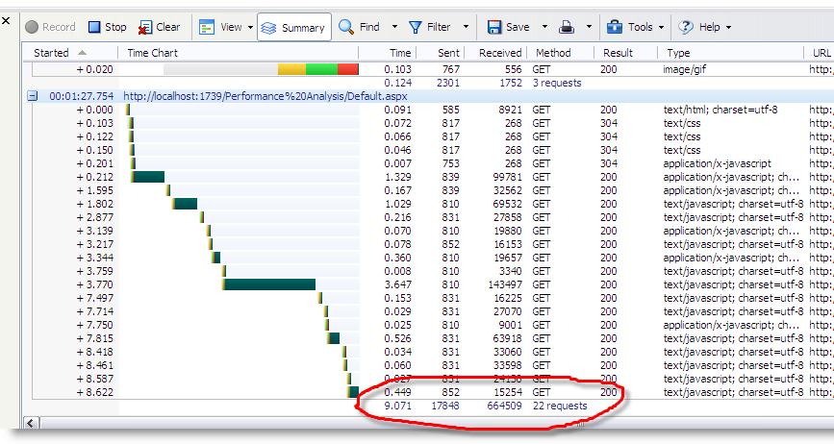
The Network Traffic
Notes:
Here's how the network traffic looked before any optimization: And we can see there are totally 22 requests and spend 9 seconds to get the 654k result. It is a really terrible in performance.

Slide 9
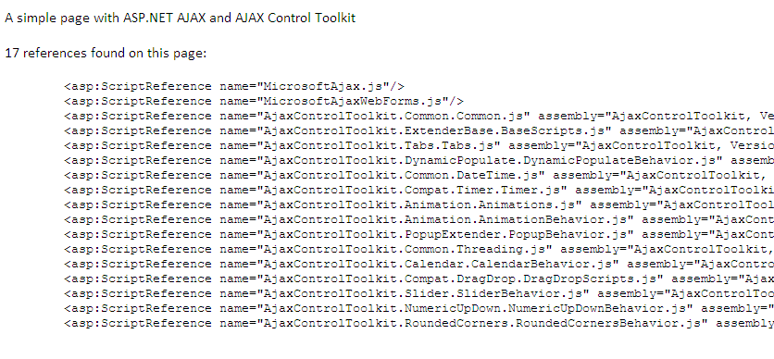
The JavaScript References
ScriptReferenceProfiler http://www.codeplex.com/aspnet/Release/ProjectReleases.aspx?ReleaseId=13356
Notes:
ScriptReferenceProfiler is an open source tool on CodePlex, for analysis the JavaScript references of ASP.NET AJAX, we can simply add the following code to our page in order to show the JavaScript references imported by ScriptManager.
We can see, before any optimization, there are 17 references found on this page, include the Microsoft Ajax Core runtime, asynchronous postback scripts, Ajax Control Toolkit Extender scripts and so on:

Slide 10
Optimization in Web.config
Cache
Compress
Best Practice in Web.config
Notes:
To optimize the ASP.NET AJAX in our web application, first of all, we need to make sure the Compression and Caching is enabled in our web.config:

Slide 11
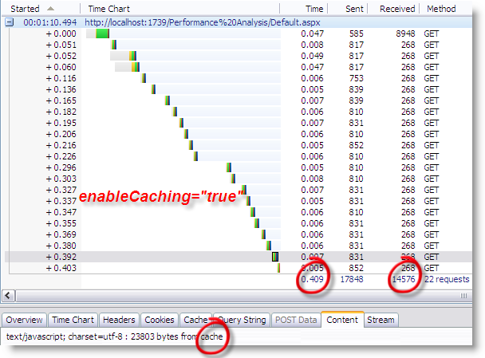
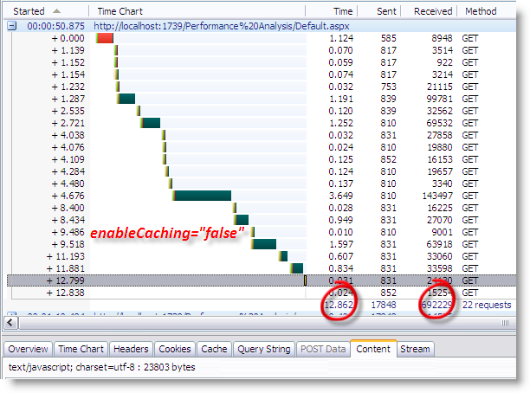
Enable The Caching
Notes:
We know, in the development of web application, enable the caching is a must operation.
To enable the caching of ASP.NET AJAX, we need make sure the enableCaching property of scriptResourceHandler is set to true.
As our expected, the page response more quickly in the second time, the expend time is coming from 12.862 seconds down to 0.409seconds; and the received size from server decrease from 692K to 14K.

Slide 12
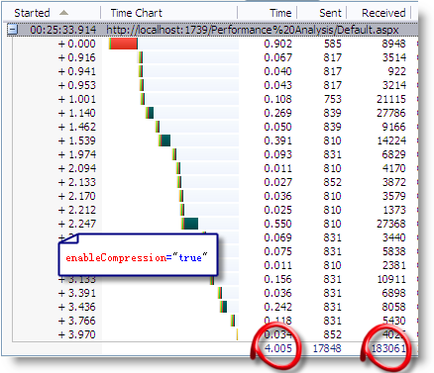
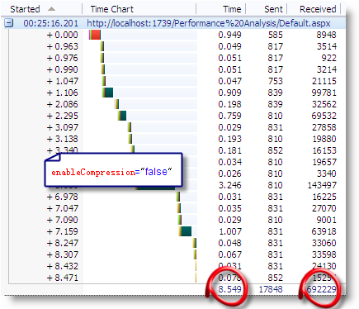
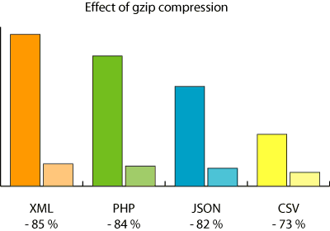
Enable The Compression
Notes:
The Caching will saving almost 95% of the network traffic in the second time we request the page, however, the first page request still ask for a huge data from server. How to reduce the first request? don't worry, set enableCompression property of scriptResourceHandler to true will help:
As we can see in the screen shot, many script files are getting smaller. and the total size decrease form 692K to 183K, about 1/4 compare to before.
♣Note: The compression is not work in Internet Explorer 6.0, because there is an known bug in IE 6, that cause the mistake might be occur when receiving the Gzip header. So the develop team close all the compression ability in IE 6.

Slide 13
Optimization in ScriptManager
Best Practice in ScriptManager
EnablePartial
Rendering
LoadScript
BeforeUI
Script Mode
Notes:
The ScriptManager control manages client script for AJAX-enabled ASP.NET Web pages. By default, the ScriptManager control registers the script for the Microsoft AJAX Library with the page. This enables client script to use the type system extensions and to support features such as partial-page rendering and Web-service calls.
Following, we need to setting the property of ScriptManager to optimize the performance of ASP.NET AJAX.

Slide 14
ScriptMode
Scott Guthrie‘s post：
Don’t leave the <compilation debug=”true”/>
It will cause:
The compilation of ASP.NET pages takes longer
Code can execute slower
Much more memory is used within the application at runtime
Scripts and images downloaded from the WebResources.axd handler are not cached
Notes:
In one of Scott Guthrie's post, he explain that we should avoid when deploying an ASP.NET application into production leave the <compilation debug=”true”/> switch on within the application’s web.config file.
1) The compilation of ASP.NET pages takes longer (since some batch optimizations are disabled)
2) Code can execute slower (since some additional debug paths are enabled)
3) Much more memory is used within the application at runtime
4) Scripts and images downloaded from the WebResources.axd handler are not cached
In this scenario, we can set the ScriptManager on the page run into the release mode to like the following:

Slide 15
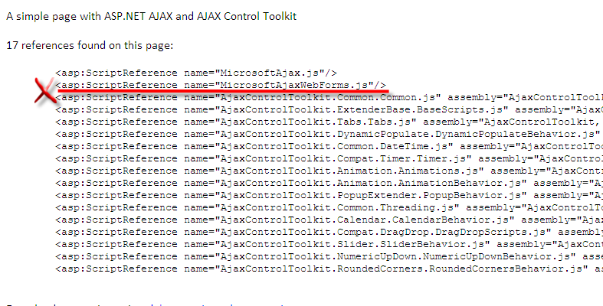
EnablePartialRendering
will be16
EnablePartialRendering:
It gets or sets a value that enables partial rendering of a page, which in turn enables you to update regions of the page individually by using UpdatePanel controls.
Notes:
There is another property in ScriptManager named EnablePartialRendering, it gets or sets a value that enables partial rendering of a page, which in turn enables you to update regions of the page individually by using UpdatePanel controls.
So, if we using the UpdatePanel in the page, we must set this property to true, conversely, if the UpdatePanel is not using in our page, it would be better that we set the EnablePartialRendering to false.
That will cause the unnecessary file "MicrosoftAjaxWebForm.js", which is used to the partial rendering not import to our page.

Slide 16
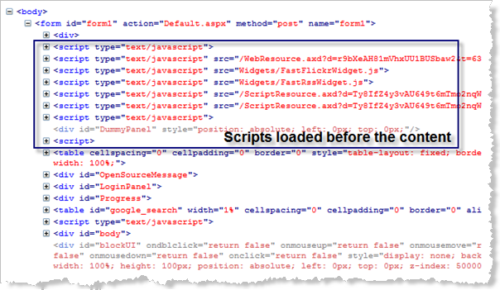
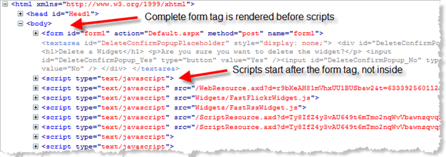
LoadScriptBeforeUI
Moving ASP.NET AJAX scripts after visible content
Notes:
ScriptManager control has LoadScriptsBeforeUI property which we can set to “False” in order to postpone several script downloads after the content is downloaded and shown. This adds the script references end of the <body> tag.
As a result, we will see the content first and then the additional scripts, exteders, AJAX Control Toolkit scripts get downloaded and initialized.
This will make the page show quikly, and provide a better User Experience.

Slide 17
Script Combination
Script B
Script A
Script C
Build up into one
Script D
Notes:
Script Combination is to build multiple script files up into one
In the previous talk, we can see the download size is coming down, but we can see the number of requests is still more than 20

Slide 18
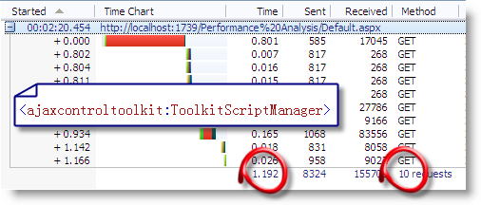
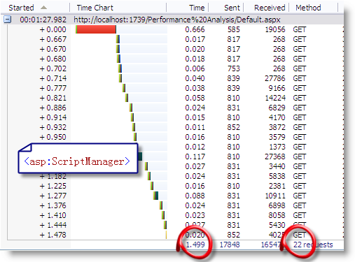
ToolkitScriptManager
Notes:
There is a ToolkitScriptManager control in the AJAX Control Toolkit, we can replace the default <asp:scriptmanager> control with this, it supports the ability to dynamically merge multiple client-side Javascript scripts into a single file that is downloaded to the client at runtime.
Better yet, only the Javascript needed by the specific controls on the page are included within the combined download, to make it as small as possible.
As the screen shot shows, It is a big savings in requests - we now get one request for Toolkit scripts instead of 12.
In this scenario, we also got about a 50% download speed improvement by only having one request.

Slide 19
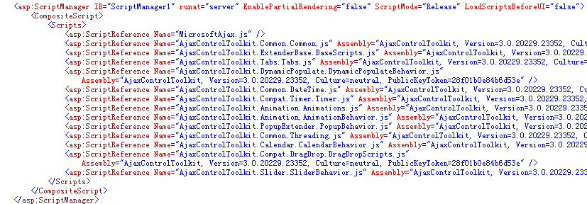
CompositeScript
ASP.NET 3.5 with SP1
Notes:
If you are using ASP.NET 3.5 with SP1, there is a more powerful tool to combining the Script file - CompositeScript.
First, We can use the ScriptReferenceProfiler to show the JavaScript references and then, we can add <CompositeScript> and <Scripts> elements as children of the ScriptManager control.
Then, Copy the script references from the page and paste them into the <Scripts> element inside the ScriptManager control, the result mark up is following:
Run the page and view the traffic. We will see just one script reference now instead of all the script inside the <Scripts> element.

Slide 20
Summary
Web.config
ScriptManager
Script Combination
Cache
Compress
ScriptMode
EnablePartialRendering
LoadScriptBeforeUI
ToolkitScriptManager
CompositeScript

Slide 21
Thank you!
&
Questions?

