Slide 1
ASP.NET Web API

Slide 2
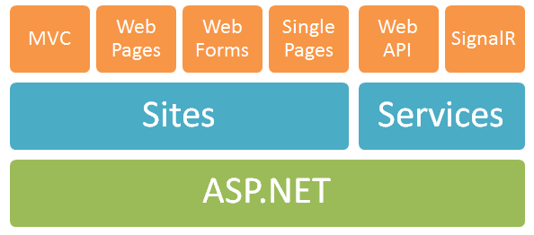
ASP.NET Members

Slide 3
MS Open Source
ASP.NET MVC 4, ASP.NET Web API and ASP.NET Web Pages v2 (Razor) now all open source
Entity Framework is Open Source

Slide 4
Why We need Web API
If your app - your business's data model - has an API, then suddenly your Web API is opened up to native apps, iPhone apps, Windows 8 apps, whatever, apps. It's Web Services.
You can use XML or JSON or something else with YourAPI. JSON is nice for mobile apps with slow connections.

Slide 5
What’s Web API
ASP.NET Web API is a framework that makes it easy to build HTTP services that reach a broad range of clients, including browsers and mobile devices.
ASP.NET Web API is an ideal platform for building RESTful applications on the .NET Framework.

Slide 6
Demo
1. Getting Started with ASP.NET Web API
2. Create Web APIs
3. Web API Clients
4. Web API Routing and Actions
5. Working with HTTP
6.Hosting ASP.NET Web API
7.Custom DelegateHandler

Slide 7
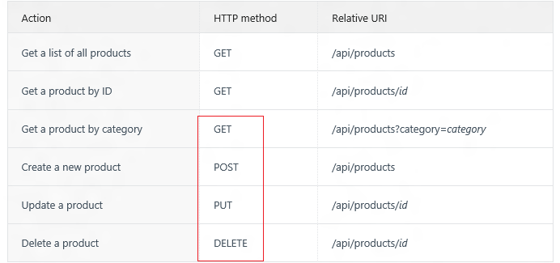
HTTP method

Slide 8
Starring ASP.NET Web API
HTML5+Knockout+ASP.NET Web API + SingleR

Slide 9
BSON and Web API
What’s BSON
Why we use it
Demo

Slide 10
Securing ASP.NET Web API
Basic Authentication
AccessKey Authentication
JavaScript Authentication
OAuth2 Authentication
…

Slide 11
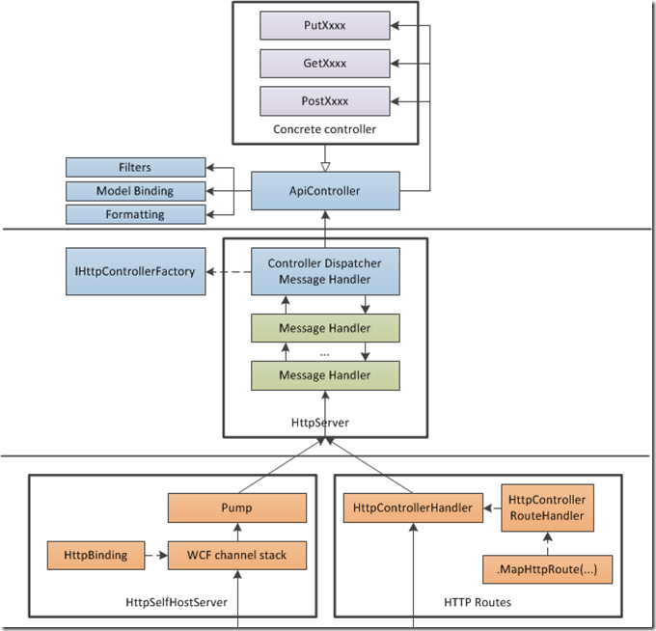
ASP.NET Web API Processing Architecture

