Slide 1
how to make a http router
珠海云创 祁宇

Slide 2
example
http://127.0.0.1/hello
Cinatra app;
app.route("/hello", [](Request& req , Response& res)
{
res.end("Hello ");
});

Slide 3
example
http://127.0.0.1/hello?name=test&age=12
Cinatra app;
app.route("/hello", [](Request& req , Response& res)
{
res.end("Hello " + req.query().get_val("name"));
});

Slide 4
more convenient
http://127.0.0.1/hello?name=test&age=12
http://127.0.0.1/hello/test/12
app.route("/hello", [](string& a, int b){});

Slide 5
essential
"hello/test/20"
magic
string to function call
hello("test", 20)

Slide 6
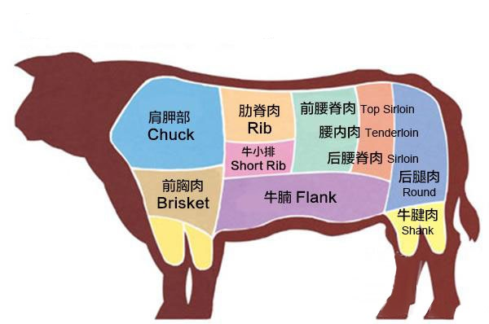

Slide 7
thinking
brower: hello
/test/20
hello("test", 20)
hello
"test" 20

Slide 8
register
template<typename Function>
void register_func(std::string const & name, const Function& f)
{
this->map_invokers_[name] = std::bind(&invoker<Function>::template apply<std::tuple<>>, f,
std::placeholders::_1, std::tuple<>());
}
apply

Slide 9
transformat param
template<typename Function, size_t N = 0, size_t M = function_traits<Function>::arity>
struct invoker;

Slide 10
transformat param
template<typename Args>
static inline void apply(const Function& func, token_parser & parser, Args const & args)
{
typedef typename function_traits<Function>::template args<N>::type arg_type;
router::invoker<Function, N + 1, M>::apply(func, parser,
std::tuple_cat(args, std::make_tuple(parser.get<arg_type>())));
}
args<N>::type
tuple_cat

Slide 11
call handler
template<typename Function, size_t M>
struct invoker<Function, M, M>
{
template<typename Args>
static inline void apply(const Function& func, token_parser &, Args const & args)
{
call(func, args);
}
};
M
M
paramters have ready, now call the function
call

Slide 12
call handler
template<typename f, size_t... i, typename ... args>
static void call_helper(f f, std::index_sequence<i...>, const std::tuple<args...>& tup)
{
f(std::get<i>(tup)...);
}
template<typename f, typename ... args>
static void call(f f, const std::tuple<args...>& tp)
{
call_helper(f, std::make_index_sequence<sizeof... (args)>(), tp);
}
index_sequence
string to function call
make_index_sequence

Slide 13
extention
RPC
MVC
Rest API
云平台
大数据

Slide 14
FAQ
source code: https://github.com/qicosmos/cosmos/blob/master/router.hpp
purecpp.org

